Slide 1
Network Health Cares
(PPO D-SNP)
2025 Model of Care Training

Slide 2
What is a Medicare Advantage
Special Needs Plan?
Special Needs Plans (SNPs) were created by Congress as part of the Medicare Modernization Act (MMA) of 2003, as a new type of Medicare-managed care plan focused on certain vulnerable groups of Medicare beneficiaries
Network Health offers a dual-eligible SNP (D-SNP), called Network Health Cares, which includes individuals who are enrolled in Medicare and Medicaid
Network Health Cares provides reimbursement for all medically necessary Medicare-covered benefits

Slide 3
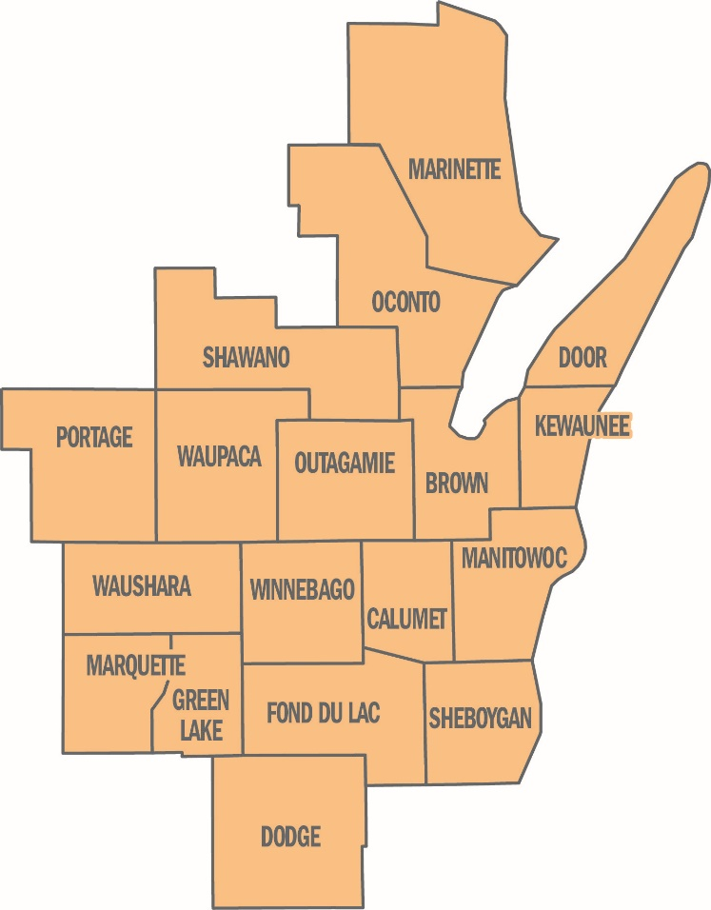
Network Health Cares (PPO D-SNP)
Eligibility and Membership
Must live in Network Health’s
18-county northeast Wisconsin service area
Must have Medicare Parts A and B and Medicaid from the state of Wisconsin
Members are still in the Medicare program, have Medicare rights and protections and receive all regular Medicare covered services

Slide 4
What is covered by
Network Health Cares?
Because this is a PPO plan, members can use any provider who accepts Medicare and Medicaid
The plan provides reimbursement for all medically necessary covered benefits, in- or out-of-network
  Medicare’s coverage rules determine which services are medically necessary
  Medicare (Network Health Cares) is the primary insurance and pays first
  Then Medicaid pays up to the Medicaid-approved amount
  Providers should not bill the member any unpaid balance
Extra benefits include dental, vision, hearing and more
  Go to networkhealth.com/medicare/extra-benefits-snp for more information

Slide 5

D-SNP Model of
Care Goals
  Improve access and affordability of health care needs
  Improve coordination of care through the direct alignment of the health risk assessment, individualized care plan and interdisciplinary care team
  Enhanced care transitions across health care settings and providers for all D-SNP members
  Ensure appropriate utilization of services for preventive health and chronic conditions

Slide 6
D-SNP Care Coordination
The Centers for Medicare & Medicaid Services requires D-SNP members to be managed by using the following.
  Health Risk Assessment (HRA)
    Initial HRA must be completed within 90 days of member’s effective date
    Annual HRA must be completed within 365 days of the previous HRA
  Individualized Care Plan (ICP)
  Interdisciplinary Care Team (ICT)
  Annual face-to-face visit

Slide 7

Health Risk Assessment
  A member of the Network Health Cares team contacts members to complete their HRA via phone
  The member’s assigned SW or RN is responsible for reviewing, analyzing and stratifying health care needs
  The member’s assigned SW or RN discusses with the member/member representative, by phone or in person, the HRA results as a basis for developing or modifying an individualized care plan

Slide 8
Individualized Care Plan
ICP Review
  The member’s assigned SW or RN reviews, updates and/or implements an ICP with the member/responsible party at least annually or as needed, if the member’s condition(s) change
ICP Communication
  The ICP and revisions are communicated by the member’s assigned SW or RN to the member/member representative by phone, electronically, fax or mail
  The RN or SW may also contact the community care partner and/or network providers by phone, fax or mail as a result of the communications plan developed during the care planning session with the member or member representative

Slide 9
D-SNP Interdisciplinary
Care Team
Every Network Health Cares member has an Interdisciplinary Care Team (ICT) that can vary depending on the needs of the member.
Composition of the ICT
    The member
    The member’s assigned care manager (RN or SW)
    The member’s personal doctor
    Any “as needed” participants
Examples of “as needed” participants
    Community care partner
    Restorative health specialist (physical, occupational, speech)
    Home care nurse, home health aide, community resources
    Pharmacist, dietitian, nutritionist
    Specialist physicians

Slide 10

Care Transitions
Care Transitions Process
  The assigned RN or SW will attempt to contact all D-SNP members within three business days of notification from a care transition
  A care transition may include, for example, planned or unplanned inpatient hospitalization, observation, skilled nursing facility stay or emergency department visit
  The assigned RN or SW and member/member representative will work together to update the member’s ICP
  ICP will be communicated to applicable members of the member’s ICT

Slide 11

Annual Face-to-Face
Encounter
All D-SNP members are required to have a face-to-face encounter in-person or through a visual, real-time, interactive telehealth encounter
Face-to-face encounters must occur at least annually
Network Health Cares promotes the annual wellness visit, conducted by the member’s personal doctor as the primary form of a face-to-face encounter
If the member does not complete an annual wellness visit, any other personal doctor visit is considered a qualifying
face-to-face encounter

Slide 12
What is the Care of Older Adults
(COA) Measure?
The intent of this measure is to ensure that older adults receive the care they need to optimize their quality of life.
As the population ages, physical and cognitive function can decline, and pain becomes more prevalent. Older adults may also have more complex medication regimens. Screening of elderly patients is effective in identifying functional decline.
Eligible Population
  Medicare-special needs population
  66 years of age and older as of December 31 of the measurement year
Exclusion
  Members who received hospice care anytime during
  the measurement year
  Members who deceased during the measurement year

Slide 13
CMS Star Measures
Dual-Eligible Special Needs Plan (D-SNP)
2025 Star Rating*
(Rated on a scale of 1 through 5, with 5 being the best)
SNP Care Management – 4 Star
COA-Pain – 5 Star
COA-Med review – 5 Star
For more information on HEDIS measures please visit our website: networkhealth.com/provider-resources/quality-health-integration
*The Network Health Medicare Advantage 2025 PPO plans earned a 5 Star Rating overall.

Slide 14
Network Health Cares contacts
  Laura Reinsch, Director of Care Management
  920-720-1602 ext. 01711
  lreinsch@networkhealth.com
  Amanda Campbell, D-SNP Manager
  920-720-1602 ext. 01533
  acampbel@networkhealth.com
Every year, Medicare evaluates plans based on a 5 Star rating system.
H5215_2264-07-1124_C

