Slide 1
Network Health Cares (PPO D-SNP) 2026 Model of Care Training

Slide 2
What is a Medicare Advantage Special Needs Plan?
Special Needs Plans (SNPs) were created by Congress as part of the Medicare Modernization Act (MMA) of 2003, as a new type of Medicare-managed care plan focused on certain vulnerable groups of Medicare beneficiaries
Network Health offers a dual-eligible SNP (D-SNP), called Network Health Cares, which includes individuals who are enrolled in Medicare and Medicaid
Network Health Cares provides reimbursement for all medically necessary Medicare-covered benefits

Slide 3
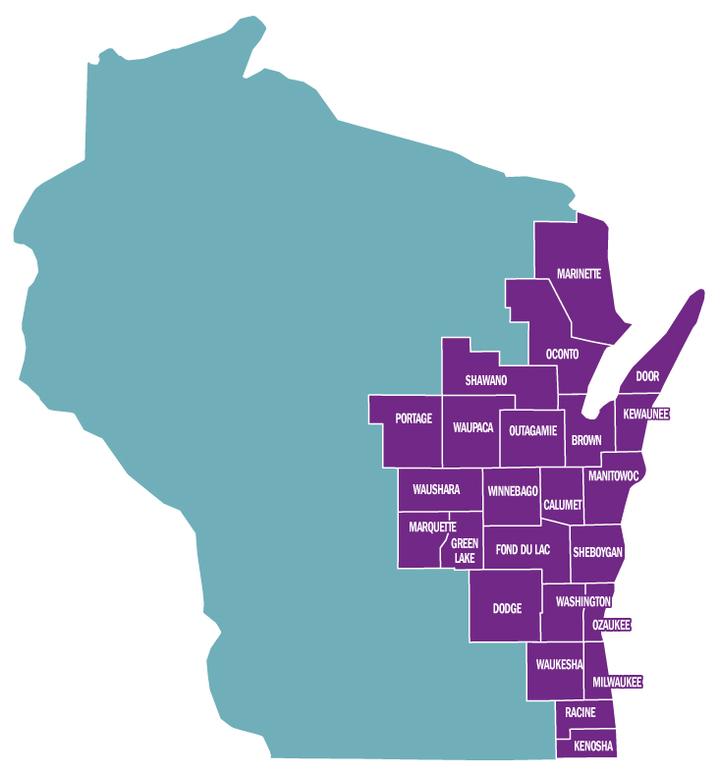
Network Health Cares (PPO D-SNP) Eligibility and Membership
Must live in Network Health’s 24-county Wisconsin service area
Must have Medicare Parts A and B and Medicaid from the state of Wisconsin
Members are still in the Medicare program, have Medicare rights and protections and receive all regular Medicare covered services

Slide 4
What is covered by Network Health Cares?
Because this is a PPO plan, members can use any provider who accepts Medicare and Medicaid
The plan provides reimbursement for all medically necessary covered benefits, in- or out-of-network
Medicare’s coverage rules determine which services are medically necessary
Medicare (Network Health Cares) is the primary insurance and pays first
Then Medicaid pays up to the Medicaid-approved amount
Providers should not bill the member any unpaid balance
Extra benefits include dental, vision, hearing and more
Go to networkhealth.com/medicare/extra-benefits-snp for more information

Slide 5

D-SNP Model of Care Goals
Improve access and affordability of health care needs
Improve coordination of care through the direct alignment of the health risk assessment, individualized care plan and interdisciplinary care team
Enhanced care transitions across health care settings and providers for all D-SNP members
Ensure appropriate utilization of services for preventive health and chronic conditions

Slide 6
D-SNP Care Coordination
The Centers for Medicare & Medicaid Services requires D-SNP members to be managed by using the following.
Health Risk Assessment (HRA)
Initial HRA must be completed within 90 days of member’s effective date
Annual HRA must be completed within 365 days of the previous HRA
Individualized Care Plan (ICP)
Interdisciplinary Care Team (ICT)
Annual face-to-face visit

Slide 7

Health Risk Assessment
A member of the Network Health Cares team contacts members to complete their HRA via phone
The member’s assigned SW or RN is responsible for reviewing, analyzing and stratifying health care needs
The member’s assigned SW or RN discusses with the member/member representative, by phone or in person, the HRA results as a basis for developing or modifying an individualized care plan

Slide 8
Individualized Care Plan
ICP Review
The member’s assigned SW or RN reviews, updates and/or implements an ICP with the member/responsible party at least annually or as needed, if the member’s condition(s) change
ICP Communication
The ICP and revisions are communicated by the member’s assigned SW or RN to the member/member representative by phone, electronically, fax or mail
The RN or SW may also contact the community care partner and/or network providers by phone, fax or mail as a result of the communications plan developed during the care planning session with the member or member representative

Slide 9
D-SNP Interdisciplinary Care Team
Every Network Health Cares member has an Interdisciplinary Care Team (ICT) that can vary depending on the needs of the member. Composition of the ICT
The member
The member’s assigned care manager (RN or SW)
The member’s personal doctor
Any “as needed” participants
Examples of “as needed” participants
Community care partner
Restorative health specialist (physical, occupational, speech)
Home care nurse, home health aide, community resources
Pharmacist, dietitian, nutritionist
Specialist physicians

Slide 10

Care Transitions
Care Transitions Process
The assigned RN or SW will attempt to contact all D-SNP members within three business days of notification from a care transition
A care transition may include, for example, planned or unplanned inpatient hospitalization, observation, skilled nursing facility stay or emergency department visit
The assigned RN or SW and member/member representative will work together to update the member’s ICP
ICP will be communicated to applicable members of the member’s ICT

Slide 11

Annual Face-to-Face Encounter
All D-SNP members are required to have a face-to-face encounter in-person or through a visual, real-time, interactive telehealth encounter
Face-to-face encounters must occur at least annually
Network Health Cares promotes the annual wellness visit, conducted by the member’s personal doctor as the primary form of a face-to-face encounter
If the member does not complete an annual wellness visit, any other personal doctor visit is considered a qualifying face-to-face encounter

Slide 12
What is the Care of Older Adults (COA) Measure?
The intent of this measure is to ensure that older adults receive the care they need to optimize their quality of life.
As the population ages, physical and cognitive function can decline, and pain becomes more prevalent. Older adults may also have more complex medication regimens. Screening of elderly patients is effective in identifying functional decline.
Eligible Population
Medicare-special needs population
66 years of age and older as of December 31 of the measurement year
Exclusion
Members who received hospice care anytime during the measurement year
Members who deceased during the measurement year

Slide 13
Network Health Cares contacts
Laura Reinsch, Director of Care Management
920-720-1602 ext. 01711
lreinsch@networkhealth.com
Amanda Campbell, D-SNP Manager
920-720-1602 ext. 01533
acampbel@networkhealth.com
H5215_2264-08-1225_C

